Slide 1
Spring Batch
Ayan Sengupta

Slide 2
What is Batch Processing
Computerized batch processing is a method of running software programs called jobs in batches automatically.
While users are required to submit the jobs, no user interaction is required to process the batch.
Batches may automatically be run at scheduled times as well as being run contingent on the availability of computer resources.

Slide 3
Spring Batch
A lightweight, comprehensive batch framework designed to enable the development of robust batch applications vital for the daily operations of enterprise systems.
Spring Batch provides reusable functions that are essential in processing large volumes of records, including logging/tracing, transaction management, job processing statistics, job restart, skip, and resource management. It also provides more advanced technical services and features that will enable extremely high-volume and high performance batch jobs through optimization and partitioning techniques. Simple as well as complex, high-volume batch jobs can leverage the framework in a highly scalable manner to process significant volumes of information.
Features
Transaction management
Chunk based processing
Declarative I/O
Start/Stop/Restart
Retry/Skip
Web based administration interface (Spring Cloud Data Flow)

Slide 4
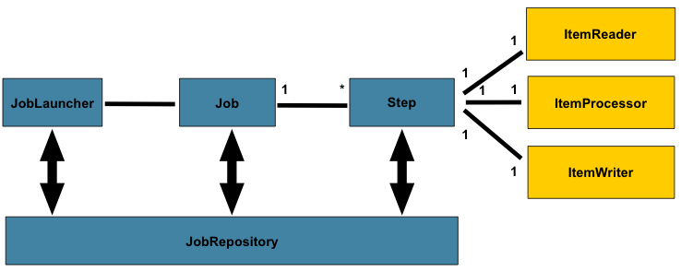
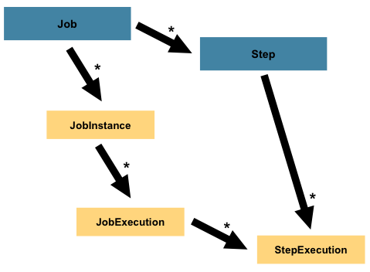
Spring Batch Components
Job is an entity that encapsulates an entire batch process.
Step is a domain object that encapsulates an independent, sequential phase of a batch job. Therefore, every Job is composed entirely of one or more steps.
ItemReader is an abstraction that represents the retrieval of input for a Step, one item at a time.
ItemProcessor is an abstraction that represents the business processing of an item.
ItemWriter is an abstraction that represents the output of a Step, one batch or chunk of items at a time.
JobRepository provides CRUD operations for JobLauncher, Job, and Step implementations.
JobLauncher represents a simple interface for launching a Job with a given set of JobParameters
JobInstance refers to the concept of a logical job run.
JobExecution refers to the technical concept of a single attempt to run a Job.
StepExecution represents a single attempt to execute a Step.

Slide 5
Scaling and Parallel Processing in Spring Batch
Multi-threaded Step (single-process)
Add a TaskExecutor to your Step configuration. TaskExecutor is a standard Spring interface. The simplest multi-threaded TaskExecutor is a SimpleAsyncTaskExecutor. The result of the preceding configuration is that the Step executes by reading, processing, and writing each chunk of items (each commit interval) in a separate thread of execution
Remote Chunking of Step (multi-process)
In remote chunking, the Step processing is split across multiple processes, communicating with each other through some middleware.
Parallel Steps (single-process)
Use Flow to create of group step(s) that need to run sequentially
Since each Flow can run parallelly use a FlowBuilder to create parallel execution
Partitioning a Step (single or multi-process)
Spring Batch consists of a special implementation of Step (called the PartitionStep) and two strategy interfaces that need to be implemented for the specific environment. The strategy interfaces are PartitionHandler and StepExecutionSplitter

Slide 6
Chunk vs Tasklet
Tasklets are meant to perform a single task within a step. Each step should perform only one defined task.
@Configuration
public class TaskletsConfig {
@Bean
protected Step readLines(JobRepository jobRepository, PlatformTransactionManager transactionManager) {
return new StepBuilder("readLines", jobRepository)
.tasklet(linesReader(), transactionManager)
.build();
}
@Bean
public Job job(JobRepository jobRepository, PlatformTransactionManager transactionManager) {
return new JobBuilder("taskletsJob", jobRepository)
.start(readLines(jobRepository, transactionManager))
.next(processLines(jobRepository, transactionManager))
.next(writeLines(jobRepository, transactionManager))
.build();
}
// ...
}
Chunks performs actions over portion of data
@Configuration
public class ChunksConfig {
@Bean
protected Step processLines(JobRepository jobRepository, PlatformTransactionManager transactionManager,
ItemReader<Line> reader,
ItemProcessor<Line, Line> processor, ItemWriter<Line> writer)
{
return new StepBuilder("processLines", jobRepository).<Line, Line> chunk(2, transactionManager)
.reader(reader)
.processor(processor)
.writer(writer)
.build();
}
@Bean
public Job job(JobRepository jobRepository, PlatformTransactionManager transactionManager) {
return new JobBuilder("chunksJob", jobRepository)
.start(processLines(jobRepository, transactionManager, itemReader(), itemProcessor(), itemWriter()))
.build();
}
}

Slide 7
References
https://spring.io/projects/spring-batch#overview
https://www.baeldung.com/introduction-to-spring-batch

